Slide 1
TECHNOLOGY PITCH
Describe the Pitch Template Instructions
To ensure consistency we ask that pitchers adhere to the prescribed format.
A blank ppt template and an example of a completed template are included
Colours can be modified to better suit company livery.
Pitchers may also provide a word document with the required information, and we will produce the final version for sign off.
Please supply a logo file and presenter picture to allow any modifications to be completed by the organising committee.
Pitch summaries will be supplied to all registered attendees prior to the workshop
Please direct any queries to contact@ascendience.com

Slide 2

COMPANY AFFILIATION
Clear Statement on Product
Product (what is it, how does it work) | Pain and Gain (what issue does it address, what opportunity does it offer)
Disruption Potential (how will it supplant or augment current solutions) | Business Model (how will it be sold, e.g. JIP, multiclient, subscription etc)
Investment (cost to participate, total investment required) | Team and Time (who is involved and is there collaboration)
Call to Action Statement Add Contact Details for more Information
XXXXX PITCH 2026
Company Logo
Presenter Picture

Slide 3

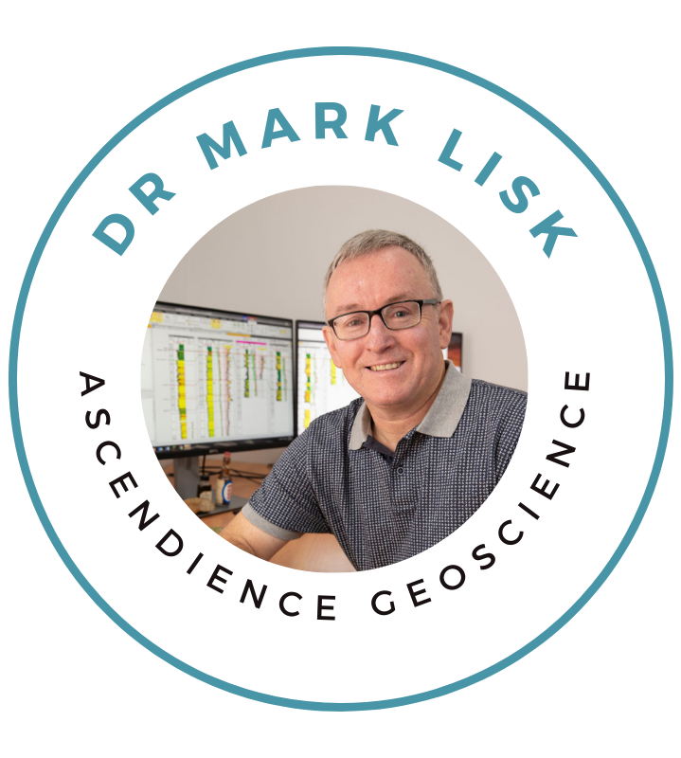
ASCENDIENCE GEOSCIENCE
Direct Measurement of Rw for more Confident Reserves Prediction
Product Irreducible water salinity within hydrocarbon zones directly measured using fluid inclusions | Pain and Gain Too few water samples = reliance on water zone logs, direct measurement solves this issue
Disruption Potential Low cost allows more samples to be analysed to provide greater constraint including in wells without core or legacy wells that lack reliable data | Business Model Flexible delivery platform with JIP or multiclient project favoured to ensure results can be placed in regional context
Investment Project budget of ca. $500k that is scalable depending on chosen AOI, with sponsor companies open to draw on EIS funding to meet a proportion of their costs | Team and Time Ascendience Geoscience to project manage and provide regional geology expertise that draws on technology input from Australia’s science agency, CSIRO
Measure Directly Reduce Assumptions contact@ascendience.com for more information www.ascendience.com
PESA WA PERTH BASIN PITCH 2023
Ascendience
Geoscience

